Slide 1
Image Enhancement Project
Submitted By
Md.Rashedunnabi
B190305022
Md.Farhan Ishtiyak Sezar
B190305011
SUBMITTED TO
Dr. Md. Zulfiker Mahmud
Professor
Dept. of Computer Science
and Engineering
Jagannath University,Dhaka

Slide 2
Introduction
Project Focus:
Enhancing image quality using advanced image processing techniques to bring out the best visual aspects in images.
Implementation:
Techniques developed and implemented in Python.
Primary Goals:
Improve Brightness – to make images visually clear.
Enhance Contrast – to better distinguish details.
Increase Color Saturation – for more vivid, life-like color representation.

Slide 3
Techniques
Color Correction
Local Contrast Enhancement
Saturation Adjustment
Brightness Adjustment
Color Transfer from Grayscale
Color Histogram Analysis

Slide 4
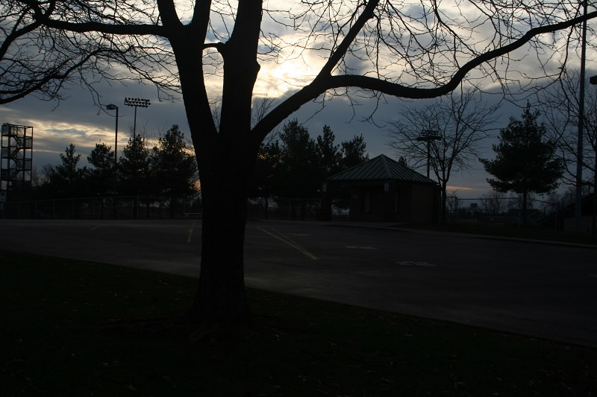
Input Image

Slide 5
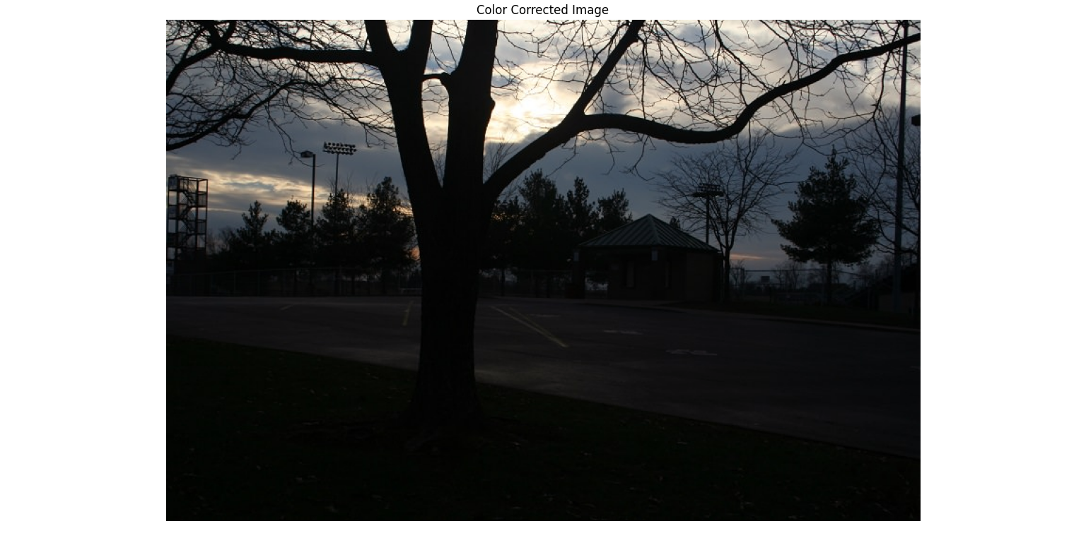
Color Correction

Slide 6
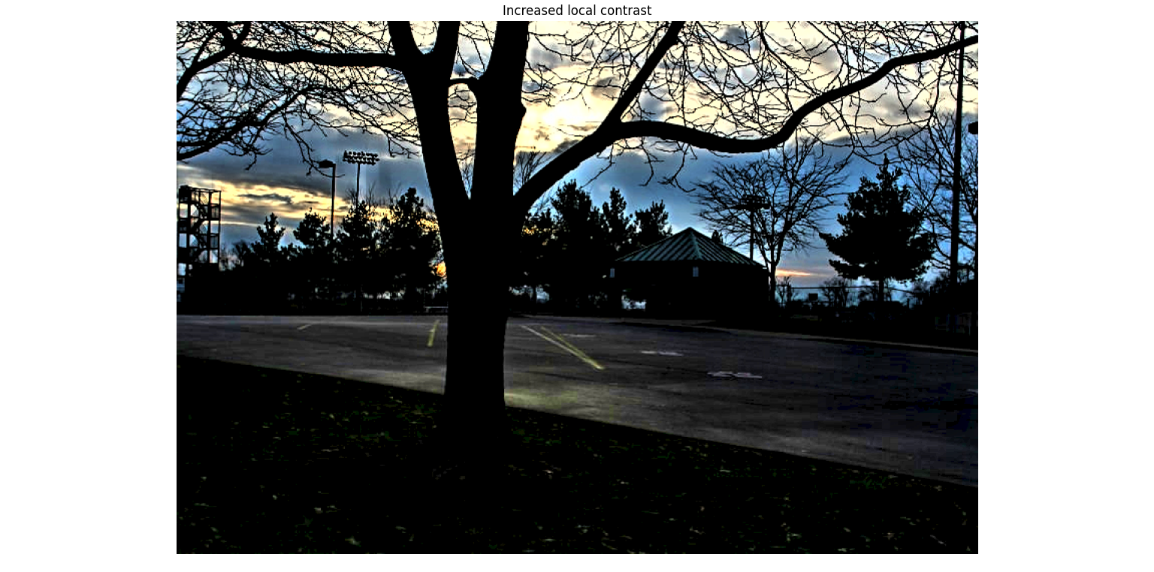
Increase Local Contrast

Slide 7
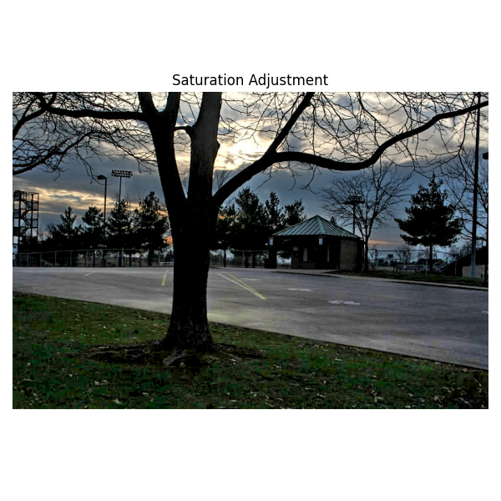
Saturation Adjustment

Slide 8
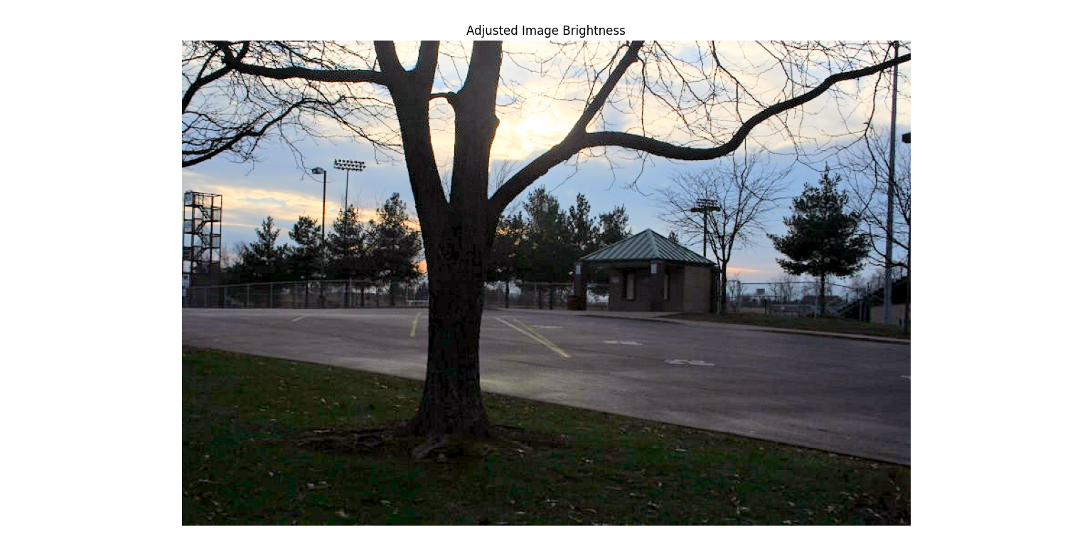
Adjusted Image Brightness

Slide 9
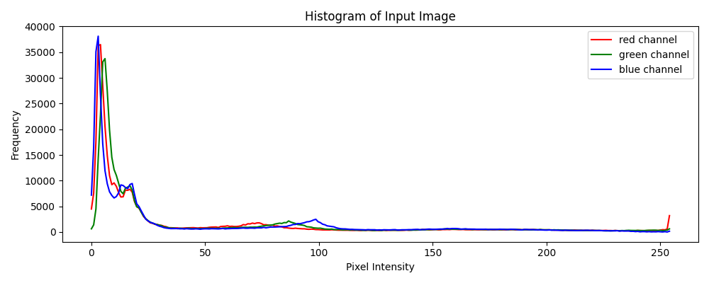
Histogram for Input Image

Slide 10
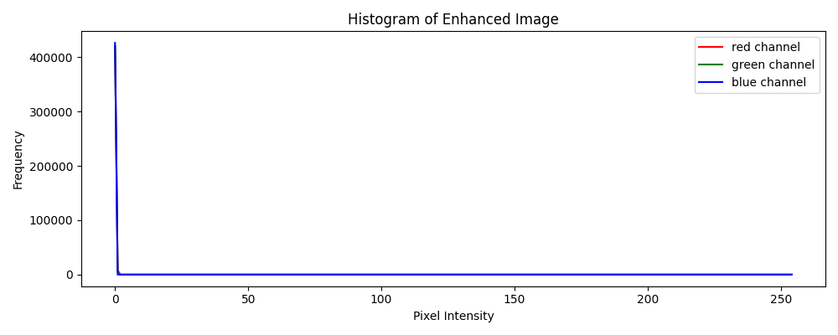
Histogram for Enhanced Image

Slide 11
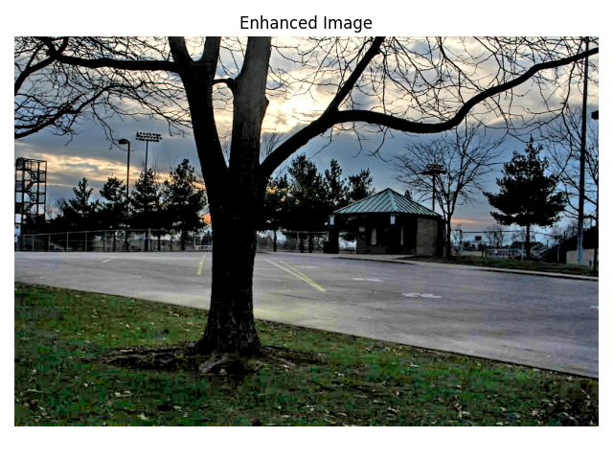
Final Output → Enhanced Image

Slide 12
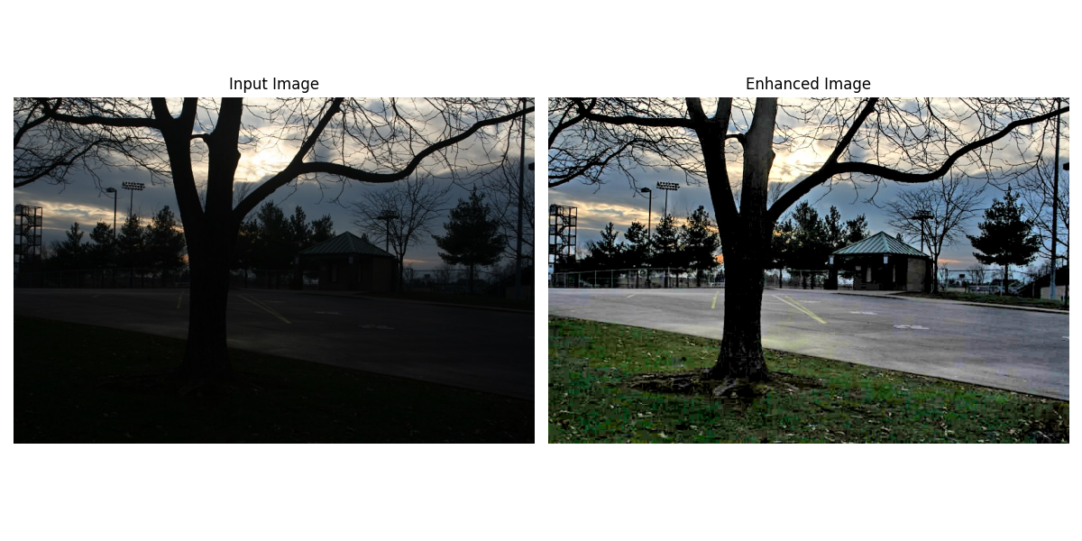
Figure-1

Slide 13
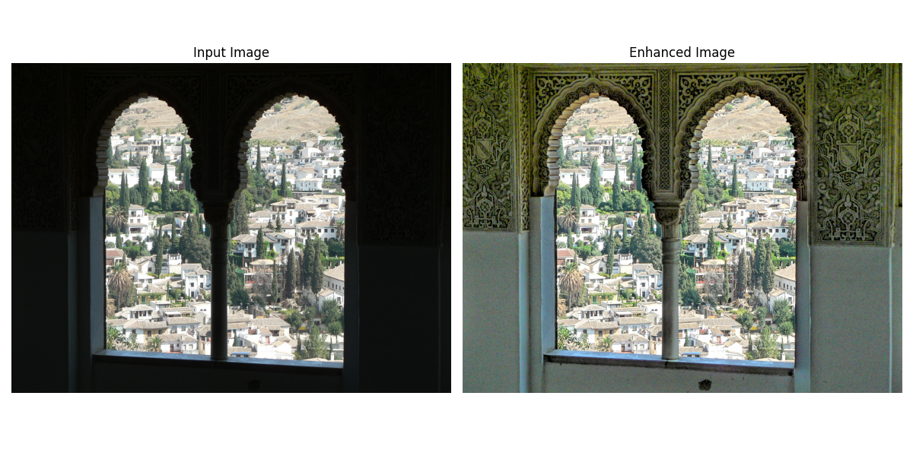
Figure-2

Slide 14
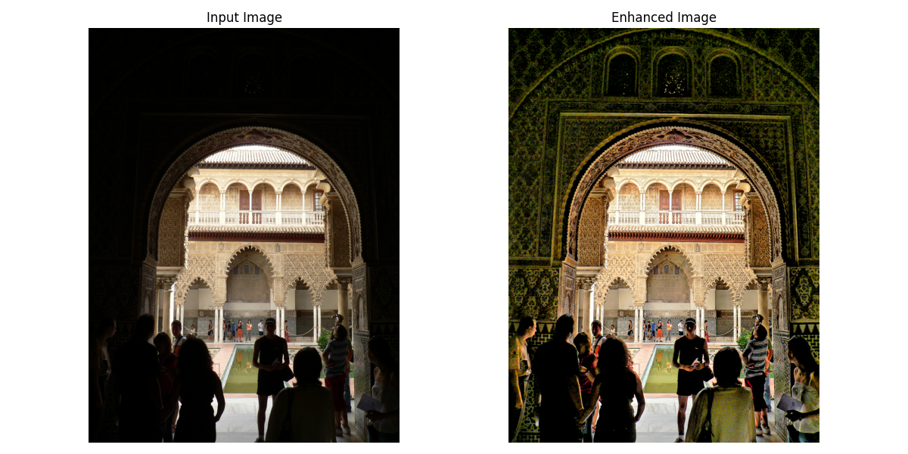
Figure-3

Slide 15
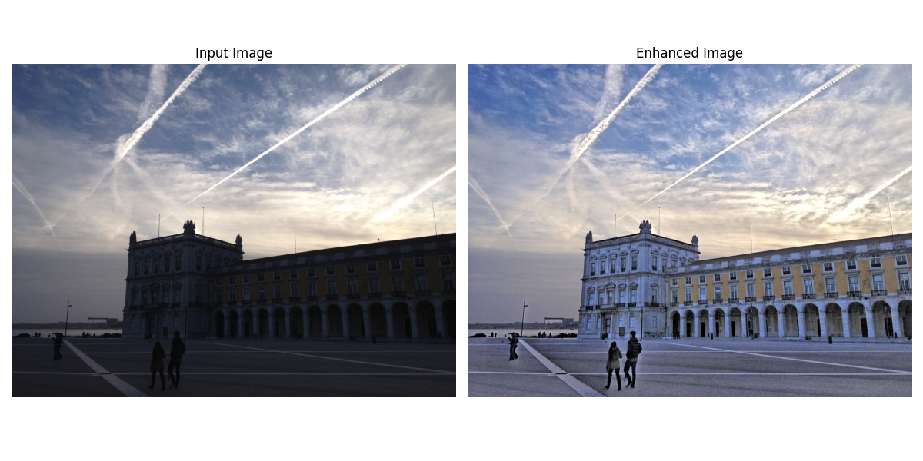
Figure-4

Slide 16
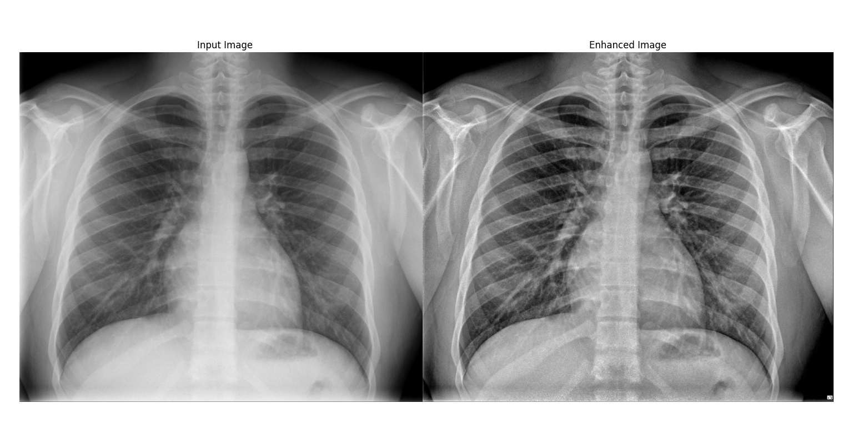
Figure-5

Slide 17
Conclusion
Results: Improved image quality by applying these techniques.
Future Work:
Explore more advanced image processing techniques.
Implement optimizations for performance and quality.
Experiment with machine learning-based methods for automatic parameter adjustment.

Slide 18


